Slide 1
Walmart
Assignment Week 4
Jorge B Rodriguez
Professor: Christos Christou
Florida National University
July 20, 2019

Slide 2
Abstract
Walmart (officially, Wal-Mart, Inc.) is a multinational corporation of American origin stores, which operates chains of discount department stores and warehouse clubs. It was founded by Sam Walton in 1962, incorporated on October 31, 1969, and has been listed on the New York Stock Exchange since 1972. Its headquarters are located in Bentonville, Arkansas.
Walmart is the largest public corporation in the world, according to the Fortune Global 500 list of 2017. It is the largest retailer in the world and offers the largest offer of private employment in the world, with more than 2 million employees- It is a family business, because the Walton family owns 48% of the company2 It is also one of the most valuable companies in the world.3 It is also the largest US grocery retailer. In 2009, 51% of its sales of US $ 258 billion. It was generated from its grocery businesses. He is also the owner and operator of Sam's Club, a chain of warehouse clubs.
Walmart has almost 11,000 stores under 65 brands in 28 countries and has e-commerce websites in 11 countries. The Walmart brand operates in the United States, including the 50 states and Puerto Rico. In North America it operates in Canada, and in Mexico with Walmart Supercenter stores and Sam's Club. In the United Kingdom, it is known as Asda; in Japan, like Seiyu; and in India, as Best Price. It has operations in Argentina, Brazil and Chile, and has a commercial presence in Costa Rica, El Salvador, Guatemala, Honduras, Nicaragua and China.

Slide 3
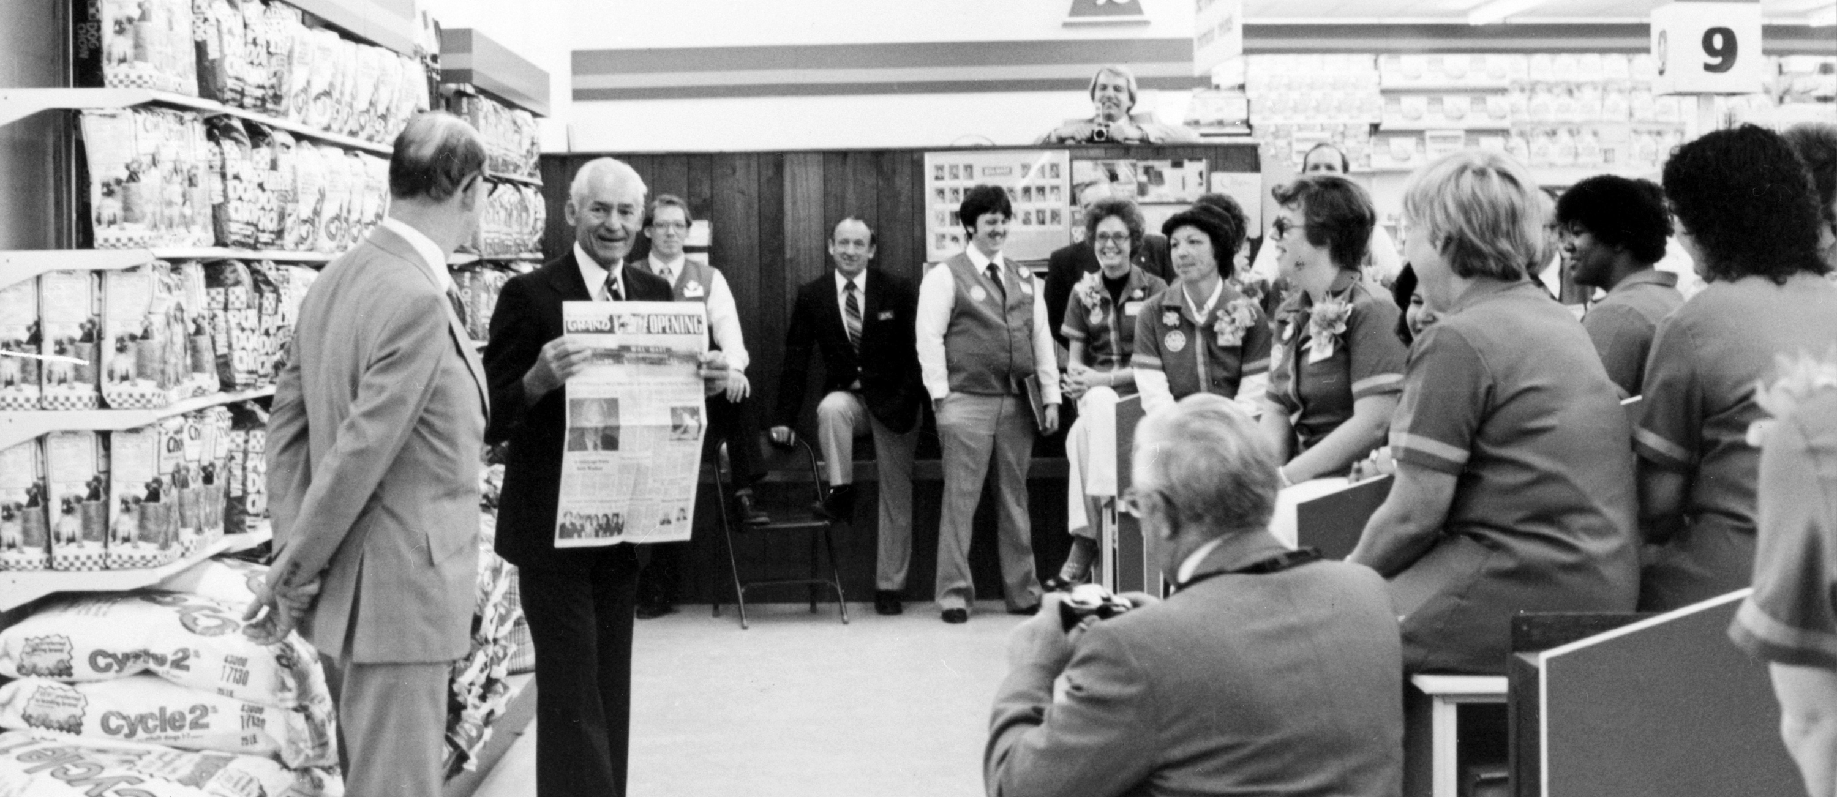
Walmart History
In 1945, Sam Walton, a businessman and former employee of J. C. Penney, bought a branch of Ben Franklin Stores, owned by Butler Brothers. Sam concentrated on selling products at a low price to obtain a higher volume of sales with a lower profit margin. This strategy was presented as a campaign in favor of the consumer. However, he had setbacks because both the rental price and the purchase price of the branch were unusually high, but he was able to get suppliers with lower costs than those used by other stores. He transferred what he saved to the prices of his products. Sales increased by 45 percent in the first year of being the owner, reaching up to $ 105,000 in annual income, an amount that increased to 140,000 in the following year and to 175,000 in the following year. By the fifth year, the store had revenues of US $ 250,000. When the local lease contract expired, Sam was unable to reach an agreement to renew it, so he opened a new Ben Franklin franchise in Bentonville, Arkansas, and called it Walton's Five and Dime. (Sam Walton Biography-An American Dream, 2019).
On July 2, 1962, Walton opened the first Walmart Discount City store, located at 719 Walnut Avenue in Rogers, Arkansas. The building is now occupied by a hardware store and an old shopping center, while the Company's "Store # 1" is located several blocks west on Walnut Street since 2013 (as it was transformed into a Supercenter concept). During the first five years, the company expanded to 24 stores throughout Arkansas and reached $ 12.6 million in sales. In 1968, he opened his first stores outside Arkansas, in Sikeston, Missouri and Claremore, Oklahoma. (Walmart, Our History, 2019).

Slide 4
Incorporation and Growth (1969-2005)
The company was incorporated as Wal-Mart Stores, Inc. on October 31, 1969. In 1970, it opened its main office and first distribution center in Bentonville, Arkansas. It had 38 stores in operation and 1,500 employees, with sales of 44.2 million dollars. It began trading as a public company on October 1, 1970, and was soon listed on the New York Stock Exchange. Its first split occurred in May 1971 at a market price of $ 47. At that time, Walmart was operating in five states: Arkansas, Kansas, Louisiana, Missouri, and Oklahoma; He entered Tennessee in 1973 and in Kentucky and the Mississippi in 1974. When he expanded to Texas in 1975, Walmart had 125 stores with 7,500 employees, and a total of $ 340.3 million in sales. Walmart opened its first store in Texas at Mount Pleasant on November 11, 1975.
In the 1980s, Walmart continued its rapid growth, and at the time of its 25th anniversary in 1987, it had 1 198 stores operating and 200,000 associates. That year also marked the conclusion of the company's satellite network, an investment of 24 million dollars that linked all the company's operating units with its office in Bentonville via two-way voice and data transmission and unidirectional video communication . At that time, it was the largest private satellite network, allowing the corporate office to track inventory and sales and instantly communicate with its stores. In 1988, Sam Walton resigned as executive director, and was replaced by David Glass. Walton remained the management advisor, and the company also reorganized other people in high-level positions. (Walmart Inc, Wiki, 2019).

Slide 5
Ethical issues Company Faces Case 1.
Walmart pays 283 MDD for bribes. With the payment, the legal cycle related to anti-corruption controls in Mexico, Brazil, India and China is closed.
The multinational self-service chain Walmart Inc. announced that it will pay $ 282.7 million (MDD) as part of a global agreement with the Department of Justice (DOJ) and the United States Securities and Exchange Commission ( SEC) to finish a seven-year investigation of bribes in countries like Mexico.
On the Mexican Stock Exchange (BMV), the shares of Walmart de México, a subsidiary of Walmart Inc., registered a 1.46% drop in the capital market. The roles of the retailer closed at 53.40 pesos.
The problems for Walmart began with an investigation of The New York Times published in 2012, where bribes were presumed to be paid to authorities in Mexican territory to open stores.
(INFORMADOR.MX, 2019).

Slide 6
Case 1. Continuation
In 2012, Walmart shares had dramatic declines. Before the scandal their roles were exchanged in the market at almost 42 pesos, but in the first days after the report was published, the shares fell 21 percent.
With the announcement of the end of the investigation of the so-called Foreing Corrupt Practices Act (FCPA), Walmart closes a legal cycle related to anti-corruption controls in Mexico, Brazil, India and China.
"Walmart Inc., under the direction of its audit committee, conducted a thorough internal investigation, and cooperated with the DOJ and the SEC, taking actions to establish a strong Compliance and Anti-Corruption Program globally," the company said. a statement sent to the BMV.
In the past seven years, Walmart has invested more than $ 900 million in requests for information and research at FCPA, in its global compliance program and improvements.
"The shares of Walmart Inc. were recognized by the DOJ and the SEC in the agreements established," the company added. (INFORMADOR.MX, 2019).

Slide 7
Wal-Mart Employee Sues the Company Case 2.
The woman alleges that the company did nothing in a porn revenge against her.
Wal-Mart responded on Monday to the lawsuit about a "pornographic revenge" of an employee, in which a woman alleges that the retail giant did nothing when she complained that a co-worker distributed sexually explicit photos of her to her colleagues of work.
"We do not tolerate any type of harassment and take these accusations seriously," said Wal-Mart spokesman Ragan Dickens. “While we have not received the complaint, we will respond appropriately in court”. (The woman claims that the company did nothing in a porn revenge against her, 2019).

Slide 8
Wal-Mart Employee Sues the Company Case 2. Continuation.
The woman is identified only as Jane Doe in her lawsuit before the Los Angeles Superior Court filed Thursday. His lawsuit identifies as additional defendants Flora García Solares, who allegedly disseminated the photos, and his ex-boyfriend and Wal-Mart worker, Lamar Davenport, whom he accuses of handing over the images to García Solares.
The accusations of the lawsuit include pornographic revenge, harassment, hostile work environment, gender discrimination, reprisals, defamation and intrusion into private matters. The lawsuit seeks compensatory and punitive damages not specified. By City News Services Published Tuesday, March 20, 2018. Wal-Mart employee sues the company. (The woman claims that the company did nothing in a porn revenge against her, 2019).

Slide 9
Ethical Issues Case 3.
Wal-Mart has faced many demands regarding its workforce. Among the main causes are low wages, poor working conditions, inadequate health care and strong anti-union policies. Those who criticize Wal-Mart, emphasize the fact that approximately 70% of employees remain less than a year working for the company. In 2006, the Los Angeles Alliance for a New Economy (LAANE) group announced that a Wal-Mart employee earns $ 10.11 per hour, which is 20% less than the industry average. In Mexico, the company was sued for paying its employees with vouchers that could only be redeemed in their same store, that is, they forced their employees to buy at Wal-Mart since it was the only way to make valid the vouchers The Federal District court accepted the lawsuit and demanded that the company stop paying the salary to its employees with vouchers.
Wal-Mart has also received accusations that involve poor working conditions due to continued abuse, many employees say they are forced to work overtime and are not paid a dollar for these hours. For example, in 2000, the company had to pay $ 50 million to settle a class action lawsuit that claimed that more than 69,000 employees in Colorado were forced to work outside their hours. In 2005, he received another class action lawsuit in Missouri because the company forced nearly 200,000 employees to work overtime without being paid and worst of all without having rest or lunch. (Walmart Case, 2019).

Slide 10
Ethical Issues Case 3. Continuation.
Wal-Mart has also received accusations that involve poor working conditions due to continued abuse, many employees say they are forced to work overtime and are not paid a dollar for these hours. For example, in 2000, the company had to pay $ 50 million to settle a class action lawsuit that claimed that more than 69,000 employees in Colorado were forced to work outside their hours. In 2005, he received another class action lawsuit in Missouri because the company forced nearly 200,000 employees to work overtime without being paid and worst of all without having rest or lunch.
Wal-Mart has also had complaints of discrimination, the Wal-Mart V Duckes case is a clear example of racism, 1.5 million employees reported that they had been discriminated against for being women, this case had a great impact on the company.
Before the continuous demands of workers towards Wal-Mart the American press began to look at this case and therefore to criticize it. The most prominent titles against Wal-Mart were "Receive Wal-Mart 100 labor demands per month.”(Walmart Case, 2019).

Slide 11
Ethical Issues Case 3. Continuation.
"The biggest scandals of Wal-Mart" and "David against Golliat. The world's largest retailer against 1.6 million women, ”the latter hinting at the power the company used to discriminate against its workers because of their gender. The New York Times, one of the most influential newspapers in the world, announced that the Wal-Mart company had blackmailed Mexican officials with 24 million dollars between 2002 and 2005 for the facilitation of building permits, change of use of salary and environmental guarantees. The newspaper also mentioned that this happened with the consent of the company's leadership in the country.
On the other hand, workers complained in the press that Wal-Mart forced them to work more than 8 hours a day, that there was a rapid change of workers and that almost always they were not given the necessary time for their lunches. The New York media also announced that the leaders of the pension funds of that city had decided not to vote for the re-election of the directors of Wal-Mart in the general meeting of shareholders because of their mismanagement in the company.
Corporations now, in their attempt to improve or increase their profitability can infringe against customers, communities, etc. This as in the case of Walmart, this group to be the successful company it is today; It offers its products at a low price, but at the cost of having low-paid workers without labor rights. (Walmart Case, 2019).

Slide 12
Ethical Issues Case 3. Continuation.
A clear example for this point is the case of Ana Sanchez, a 45-year-old Mexican immigrant who worked in a warehouse. One day as he rushed to cover an order, he fell and was injured. Despite having an impeccable track record, the company fired him, arguing that a paperwork error had happened, but it was nothing else that Walmart did not want to bear medical expenses.
In summary, it can be concluded that the main affected in front of these measures were the workers and this because Walmart was not willing to pay the medical insurance of the employees. This with the sole purpose of reducing costs and thereby continue to offer comfortable prices on their products, even at the expense of the lives of their employees. (Walmart Case, 2019).

Slide 13
Moral Issues Case 4.
In this case, it is not moral for workers to be forced to work overtime without receiving in return any compensation for the work performed, which resulted in the majority of employees filing various complaints for the abuses they received; generating a tense environment between workers and Walmart.
- It is not morally accepted that Walmart has applied the strategy of establishing low prices for its products, which caused the company to be frowned upon by people, since these people were affected by their stores, supermarkets, etc. ; since they believed that it was not fair for a transnational Walmart to compete with them, which in the end caused these people to strongly repudiate this company and in many cases they protested for Walmart stores to leave their villages. (Walmart Case, 2019).

Slide 14
Ethical Issues Case 5.
In this case it is good to highlight that it is not ethical for Walmart to have a greater preference for hiring male staff, leaving aside the female workforce. The whole society knows that both women and men should have the same job opportunity and therefore neither of these two genders should be discriminated against.
- In addition, we all know that it is unethical that a company only seeks its personal benefit and neglects the welfare of the people who work within that company. In the Walmart case, the shareholders saw the way to generate more income, but the result of this was that their workers were immersed in deplorable working conditions, generating an unease in people worldwide. (Walmart Case, 2019).

Slide 15
References
Walmart, Our History. (2019) Recovered, July 19, 2019, from
https://corporate.walmart.com/our-story/our-history
Walmart Inc, (2019) Recovered, July 20, 2019, from
https://en.wikipedia.org/wiki/Walmart
Sam Walton Biography-An American Dream, (2019) Recovered, July 20, 2019, from
https://www.youtube.com/watch?v=R_gSpEXv4Yo

Slide 16
References
EPIC Battle between Walmart and Amazon | Walmart Case, (2019) Recovered, July 20, 2019, from
https://www.youtube.com/watch?v=cJY7jhD5fC0
INFORMADOR.MX, (2019) Recovered, July 20, 2019, from
https://www.informador.mx/economia/Walmart-paga-283-MDD-por-caso-de-sobornos-20190621-0003.html
By City News Services Published Tuesday, March 20, 2018. Wal-Mart employee sues the company. The woman claims that the company did nothing in a porn revenge against her, (2019) Recovered, July 20, 2019, from
https://www.telemundo52.com/noticias/local/Empleada-de-Wal-Mart-demandan-a-la-compania-477388153.html

Slide 17
References
Walmart Case, (2019) Recovered, July 20, 2019, from
http://casowalmart.blogspot.com

Slide 18
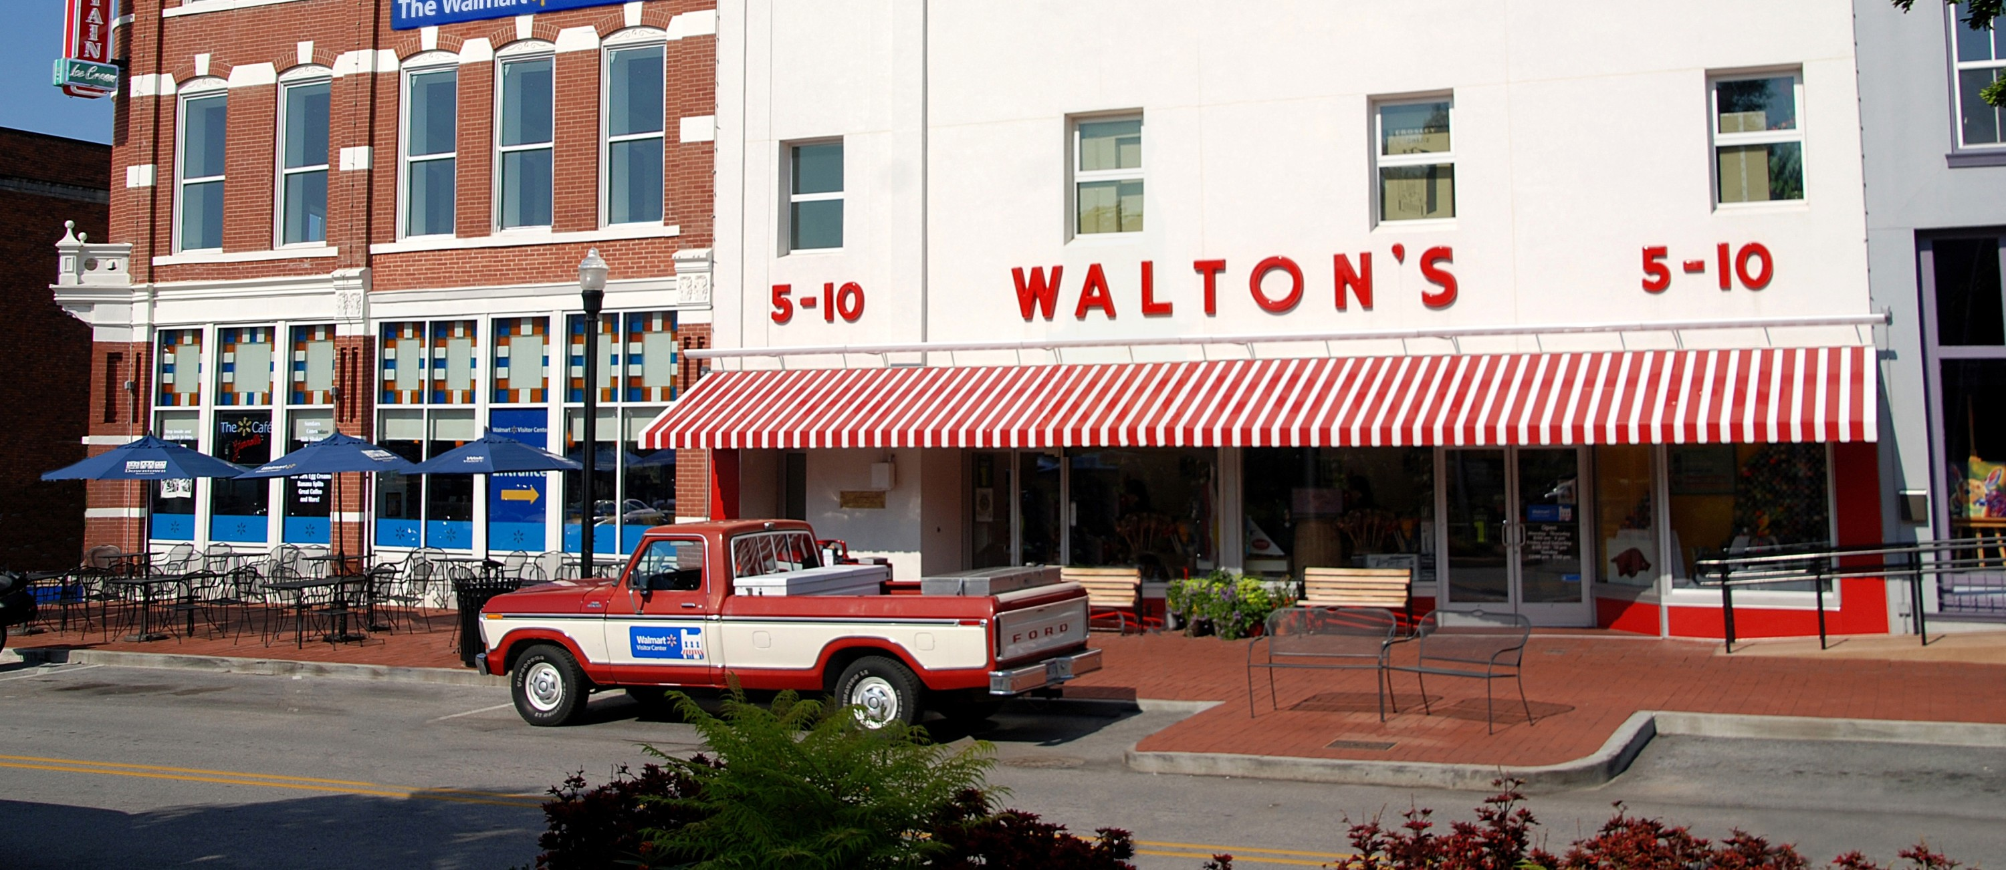
The Walmart Museum Figure #1
Notes:
When Sam Walton opened his 5&10 on the Bentonville town square in 1950, he had no idea he'd planted the seeds for what would become the global leader in retail, saving millions of people money so they could live better. Today, that humble little dime store is the location of the Walmart Museum and offers a family-friendly experience featuring a world-class exhibit gallery, Walton's 5&10, and the Spark Café Soda Fountain.

Slide 19
On July 2, 1962, Sam Walton opens the first Walmart store in Rogers, Arkansas. Figure #2
Notes:
The 1960s
Retail Revolution. Sam Walton's strategy is built on an unshakeable foundation: the lowest prices anytime, anywhere.

Slide 20
Walmart Celebrates its First $1 billion Sales week. Figure #3
Notes:
While receiving the Medal of Freedom, Sam Walton articulates the company’s mission of saving people money so they can live better, shortly before passing away at age 74. Rob Walton becomes chairman of the board. Walmart employs 371,000 associates in 1,928 stores and clubs.

Slide 21
2009 Mike Duke becomes CEO. Figure #4
Notes:
Walmart enters Chile with the acquisition of a majority stake in D&S S.A.
For the first time, Walmart exceeds $400 billion in annual sales.

Slide 22
Walmart expands into Canada with the purchase of 122 Woolco stores. Figure #5
Notes:
New Millennium Walmart enters the new millennium dedicated to offering customers seamless shopping experience, whether they are online, in a store or on a mobile device.

Slide 23
Walmart opens its Culinary & Innovation Center. Figure #6
Notes:
Present. Leading the Future of Retail. Walmart continues to pave the way in retail innovation, benefiting customers and associates alike by leveraging new technology and learning from its expanding family of brands.

Slide 24
END

